Slide 1
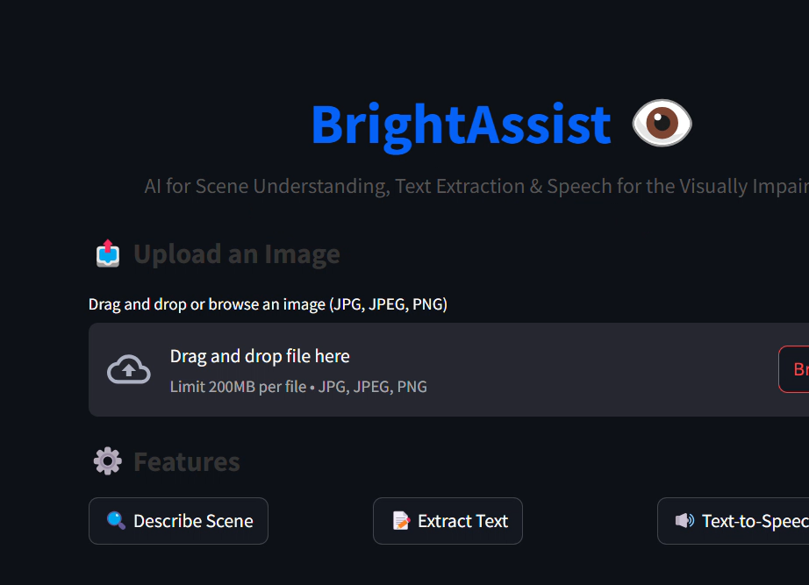

AI-Powered Assistive Technology for the Visually Impaired
This presentation introduces VisionAssist, an AI-powered solution designed to empower visually impaired individuals and improve their independence and quality of life.
by Md Prince

Slide 2
Problem Statement
Environmental Challenges
Accessibility Limitations
Visually impaired individuals face difficulties navigating bustling environments, identifying objects, and understanding their surroundings.
Current assistive technologies often lack comprehensive functionality or user-friendliness, hindering their effectiveness.

Slide 3
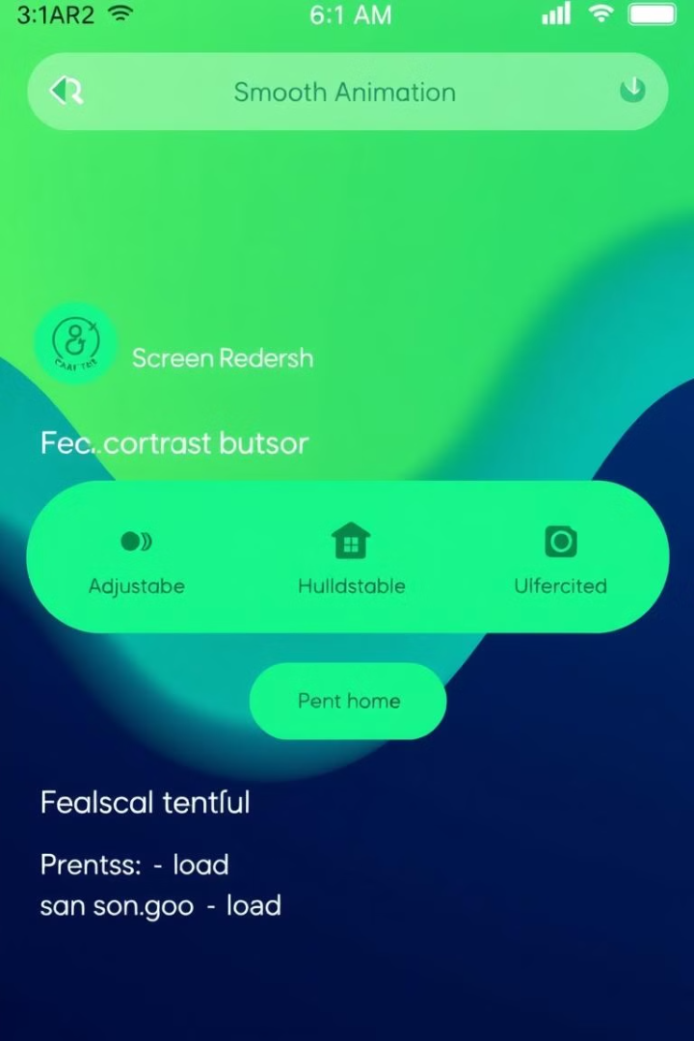
Solution Overview
1
1. VisionAssist Application
2
2. Streamlit-Based Platform
VisionAssist is a comprehensive, AI-driven application designed to empower visually impaired individuals with real-time visual understanding and accessibility features.
Built on Streamlit, VisionAssist provides an intuitive and interactive interface, ensuring ease of use for all users.
3
3. Real-Time Scene Understanding
Leveraging cutting-edge AI, VisionAssist analyzes images to provide detailed descriptions of scenes, objects, and text, making environments accessible and understandable.

Slide 4
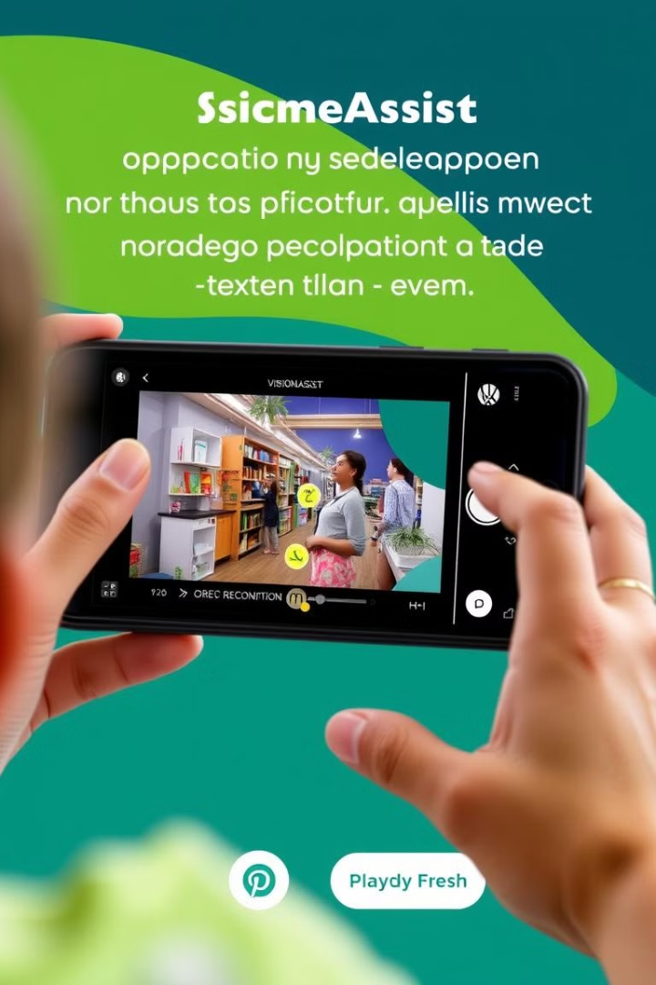
Key Features of VisionAssist
Real-Time Scene Understanding
Text Extraction and Speech
AI-generated insights about the objects and surroundings in an image, providing users with a clear understanding of their environment.
Leveraging OCR technology, VisionAssist extracts text from images and converts it into audible speech, enabling access to written information.
Object Detection and Navigation
Optional feature providing object detection for safe navigation, helping users avoid obstacles and navigate their environment with confidence.

Slide 5
Technology Stack
Streamlit
Google Generative AI
Tesseract OCR
pyttsx3
Streamlit, a popular open-source Python library, provides a user-friendly framework for building interactive web applications. It enables rapid prototyping and development, making it ideal for developing VisionAssist.
VisionAssist employs the robust Tesseract OCR engine to accurately extract text from images, enabling users to access information even from visual content.
The pyttsx3 library enables text-to-speech functionality, converting extracted text into audible speech, providing a comprehensive accessibility solution.
Utilizing Google Generative AI (Gemini API), VisionAssist leverages the power of cutting-edge language models for generating detailed and accurate scene descriptions.

Slide 6
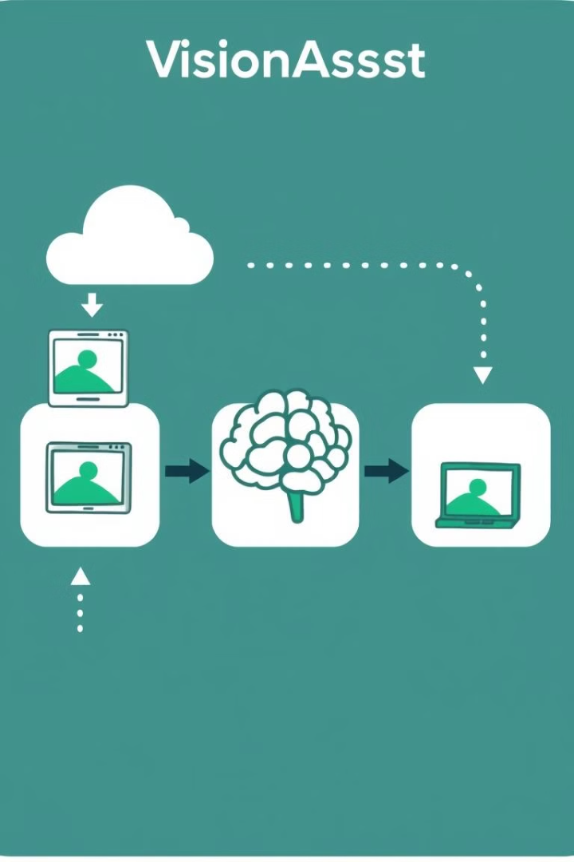
Implementation Highlights
1
1. Image Upload
Users can upload images in JPEG or PNG format to VisionAssist, allowing them to analyze real-world scenarios and documents.
2
2. Feature Selection
VisionAssist offers a range of features, including scene description, text extraction, and text-to-speech conversion, allowing users to choose the functionality they need.
3
3. AI Processing
VisionAssist utilizes its integrated AI models to process the uploaded image and deliver the requested results, providing users with valuable insights and accessibility.

Slide 7




Addressing Challenges
API Integration
Streamlining the integration of APIs, such as Google Generative AI and Tesseract OCR, to ensure seamless and efficient functionality.
Real-Time Processing
Optimizing the application for real-time processing, enabling fast and responsive interactions for users.
Accuracy Enhancement
Fine-tuning AI models and implementing pre-processing techniques to improve the accuracy of scene descriptions and OCR outputs.

Slide 8




Evaluation Criteria
Uniqueness
1
Innovative use of generative AI for assistive purposes.
Functionality
2
Implementation of at least two key features.
Technical Accuracy
3
Reliable scene understanding and OCR outputs.
Documentation
4
Clear and concise project documentation.

Slide 9
Future Directions
Object Detection
1
Expanding VisionAssist to include real-time object detection for enhanced navigation and safety.
Multi-Language Support
2
Implementing multi-language support to enhance accessibility for a wider global audience.
Wearable Integration
3
Integrating VisionAssist with wearable devices for seamless and convenient assistance.

Slide 10
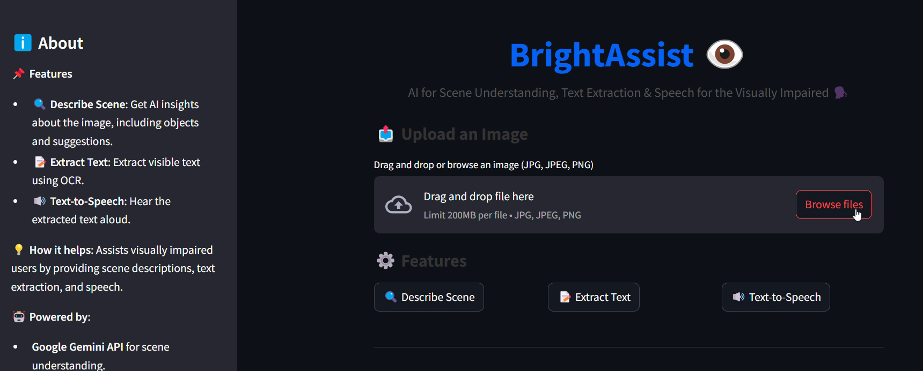
Conclusion
VisionAssist holds immense potential to transform the lives of visually impaired individuals by empowering them with greater independence, knowledge, and accessibility.

